Slide 1
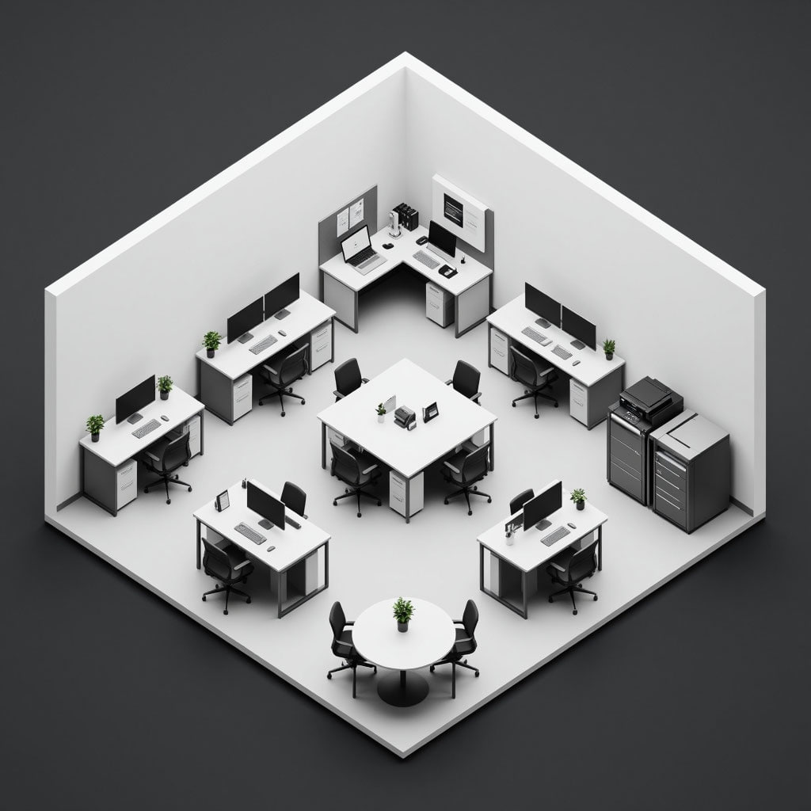
Тема проекта:
«Создание макета помещения по ТЗ»
Студенты:
Михаил Боков
Степан Пестов
Максим Шильников

Slide 2
Terms of Reference
A company asks yo u t o recommend a compute r and wor k station configuration
for thei r sales team. In small groups, decide what t o recommend. Use the office
floor plan below t o prepare the compute r and wor k station configuration. Think
about these things:
1 There are six people in the sales team.
2 Five people are out of the office four days of the week.
3 One person is in the office all the time - the team admin assistant.
4 Employees need a network connection (wired and wireless).
5 Employees print, scan and copy.
6 Company and client data mus t be stored on a separate device and backed
up regularly.

Slide 4
Person 1:
A company asked us to recommend computers and workstations for their sales team. There are six people on the team. Five are out of the office four days a week. One admin assistant is in the office every day. The office started with no furniture. We added all the desks, chairs, and other items as part of the project.
Person 2:
The floor plan shows a room with white walls and a gray floor. There are eight desks with chairs. Some desks have one screen, some have two. Plants are on a few desks. A round table with two chairs and a plant is in the front. A printer and file cabinet are in the right corner. Next to the printer, in the right bottom corner, we placed a server for backups and to share internet in the office.
Person 3:
We suggest laptops for all six people. Laptops are easy to carry, so the five salespeople can work anywhere. For the admin, add a big screen and keyboard at their desk. All laptops need wired and wireless networks. The shared printer can print, scan, and copy. This setup saves money with no extra big computers. It fits a team that moves a lot. Data stays safe on the server, not on laptops. Everyone can connect and print easily

Slide 5
End

